Slide 1
Faculty Appointments
Processes and Timelines

Slide 2
New appointments - Start to Finish
CE, Tenure, Research
  Assistant rank new hire = 7 months
  Associate or Full rank new hire = 9 months
AC
  Assistant rank new hire = 5 months
  Associate or Full rank new hire = 7 months

Slide 3
Appointment of FT Faculty
3 Concurrent Processes
  Search
  Recruitment – RTR, Offer letter, Comp Statement
  Appointment - dossier
Academic Review Process

Slide 4
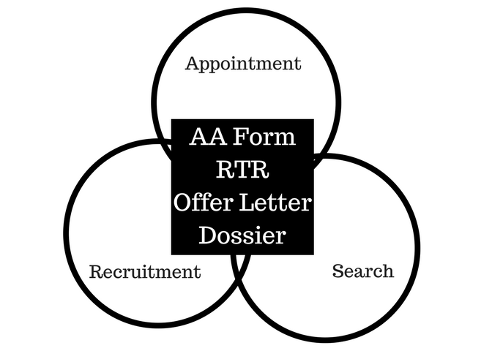
Concurrent Processes

Slide 5
Search
National Search – Tenure, CE, Research
  Minimum of 3 month posting
Limited Search – AC
  Minimum 1 month posting
Add text is templated
  Must be approved before posting – Ad Generator application
All applicants are tracked - Interfolio Faculty Search (FS)
Identification of Preferred Candidate

Slide 6
Recruitment
Start as soon as preferred candidate is identified
All funding channels identified
Distribution of effort must be in alignment with expectations of track
  CE - 30% is the most appropriate amount of "protected" time. The typical range is between 20-30, but variable
  AC – no more than 90% clinical effort, at least 10% protected for academic
Predominant time spent in department & negotiations with candidate
CSO Review (RAC)
RTR online
Start to end variable

Slide 7
CSO Review – all Tenure track
Terms of Recruitment Request Form
Completed recommendation by department chair
Candidate’s curriculum vitae and grant support
Candidate's statement of research plan and/or program
Letters of recommendation
Summary of the search process
  interview itineraries
  Evaluations
  chalk talk/seminar flyers
Summary of the start-up package including space and dollars/sources
Expectations and metrics for assessment of success

Slide 8
Appointment Dossier
Team
  Chair
  Division Chief
  Search Committee Chair
  BA
  DCOAP Chair
  Education Officer
FC is project manager

Slide 9
Appointment Dossier
Assistant rank new appt. dossier
Assoc. or Full new appt. dossier
Chair’s Rec. letter
Academic Plan
2 internal letters of Rec.
2 external letters of Rec.
FEDS CV & Grants
Chair’s Rec.
Academic Plan
Extramural Consultant letters
Teaching Documentation
Personal Statement
FEDS CV & Grants
Notes:
Generally speaking… some variations (ACs for example do not have Extramural Consultant letter solicitation; they have “Peer Reference” evaluation solicitations)

Slide 10
How might a BA get involved?
Help identify hiring needs
Completing the RTR process – compensation , grants, space etc.
Assisting with Academic Plan
  allocation of effort
Editing an offer letter
Talking to the faculty member
  Directing them to appropriate resource

Slide 11
Appointment Dossier

Slide 12
Life of a dossier
Department FAPD
  AD Hoc committee reviews for senior ranks
FAPD COAP
FAPD
FAPD Dean
FAPD
FAPD PSC/PSCS

Slide 13
Appointment dossier
Assistant rank – submit 2 months before proposed start date
          3 months before for July 1
Associate & Full – submit 4 months before proposed start date
PSOM COAP – meets ~ 2x / month
PSC – meets ~ 1-2x / month
PSCS – meets ~ 2x / month

Slide 14
Appointment Timelines
Search Documentation Review Total Time
Search
RTR
Dossier
CE/Ten/Res
Assistant 3 months 2 months 2 months = 7 months
Assoc. or Full 3 months 3-4 months 3-4 months = 9 months
AC
Assistant 1 month 2 months 2 months = 5 months
Full 1 month 2-3 months 3-4 months = 7 months

Slide 15
Backwards Planning – new Appointments, July 1
Assistant Professor
January February March April 1 July 1
Identify candidate Finalize Search Submit RTR Submit Dossier START
Begin RTR/ Search / Dossier
Associate & full Professor
November December January March July 1
Identify candidate Submit RTR Finalize Search Submit Dossier START
Begin RTR/Extramural/CV Submit Extramurals

Slide 16
Reappointment Quick Facts
Dossier Docs
Timeline
Assistant Tenure, Assistant CE, Research track
Chair’s Rec Letter
Academic Clinicians
Academic Plan/Ed Officer Report (now just one doc!)
Academic Plan (except Research Professors)
Ed Officer Report (except all Research track)
CV
Reappointment Candidates contacted year prior to effective date (contact summer ‘19 for 7/1/20 reappointment)
Dossier reviewed by DCOAP in fall
Dossier submitted to FAPD for PSOM COAP & Provost review in January
Typically takes 10-12 months

Slide 17
Promotion Quick Facts
Dossier Docs (loosely defined)
Timeline
Chair’s Rec Letter
Academic Plan
CV (w/ grants page)
EDB
Extramural Consultant Letters
Personal Statement
Intramural Letters
Clinical Evaluations (AC track)
Typically 18 months
DCOAP vote no later than January of year PRIOR to effective date
For 7/1/21 promotions, DCOAP reviews in Fall of 2019
February – Promotion workshops for candidates/Faculty Coordinators
May – Deadline of submission for EDBs and extramural lists
Summer – finalize dossier
Fall of year prior to effective date – dossier finalized for PSOM COAP and Provost

